Slide 1



MICROCONTROLLER BASED SYSTEM DESIGN
CSE 3215
Lecture 10

Slide 2
Parallel communication
Parallel communication is a method of conveying multiple binary bits simultaneously.
The mechanism for parallel transmission is a conceptually simple one: Use n wires to send n bits at one time. That way each bit has its own wire, and all n bits of one group can be transmitted with each clock tick from one device to another.

Slide 3
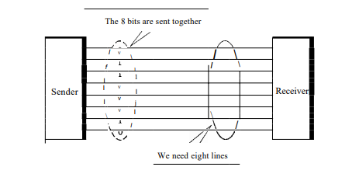
Parallel communication
Figure shows how parallel transmission works for n =8. Typically, the eight wires are bundled in a cable with a connector at each end.

Slide 4
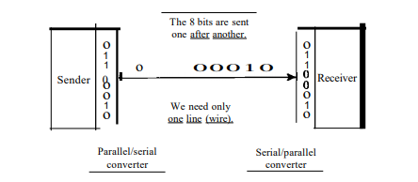
Serial communication
Serial communication is the process of sending data one bit at a time, sequentially, over a communication channel or computer bus.
Serial transmission occurs in one of three ways: asynchronous, synchronous, and isochronous.

Slide 5
Serial VS Parallel Communication
Topic | Serial Communication | Parallel Communication
Number of bits transmitted in one clock cycle | One bit. | n bits.
Number of lines required to transmit n bits | One line. | n lines.
Speed of data transfer | Slow. | Fast.
Cost of transmission | Lower as only one line is required. | Higher as n lines are required.
Application | Long distance communication between two devices. | Short distance communication between two devices.

Slide 6
Asynchronous Serial Communication
Asynchronous transmission is so named because the timing of a signal is unimportant.
The communicating endpoints' interfaces are not continuously synchronized by a common clock signal.
Instead, information is received and translated by agreed upon patterns.
Patterns are based on grouping the bit stream into bytes. Each group, usually 8 bits, is sent along the link as a unit.

Slide 7
Asynchronous Serial Communication
Without synchronization, the receiver cannot use timing to predict when the next group will arrive.
To alert the receiver to the arrival of a new group, therefore, an extra bit is added to the beginning of each byte. This bit, usually a 0, is called the start bit.
To let the receiver know that the byte is finished, 1 or more additional bits are appended to the end of the byte. These bits, usually Is, are called stop bits.
By this method, each byte is increased in size to at least 10 bits, of which 8 bits is information and 2 bits or more are signals to the receiver.
In addition, the transmission of each byte may then be followed by a gap of varying duration. This gap can be represented either by an idle channel or by a stream of additional stop bits.

Slide 8
Asynchronous Serial Communication
The start and stop bits and the gap alert the receiver to the beginning and end of each byte and allow it to synchronize with the data stream.
This mechanism is called asynchronous because, at the byte level, the sender and receiver do not have to be synchronized. But within each byte, the receiver must still be synchronized with the incoming bit stream.
That is, some synchronization is required, but only for the duration of a single byte. The receiving device resynchronizes at the onset of each new byte. When the receiver detects a start bit, it sets a timer and begins counting bits as they come in. After n bits, the receiver looks for a stop bit. As soon as it detects the stop bit, it waits until it detects the next start bit.

Slide 9
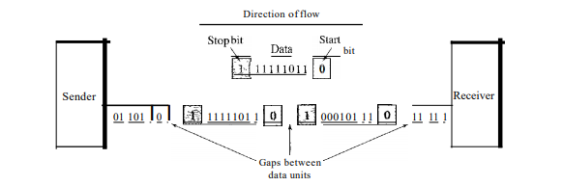
Asynchronous Serial Communication
The addition of stop and start bits and the insertion of gaps into the bit stream make asynchronous transmission slower than forms of transmission that can operate without the addition of control information. But it is cheap and effective.

Slide 10
Synchronous Serial Communication
In synchronous transmission, the bit stream is combined into longer "frames," which may contain multiple bytes.
Each byte, however, is introduced onto the transmission link without a gap between it and the next one.
Data rate for the link must be same for the transmitter and the receiver.

Slide 11
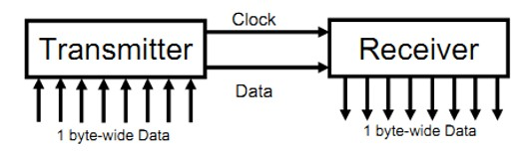
Synchronous Serial Communication
Both transmitter and receiver share a common clock.
The transmitter typically provides the clock as a separate signal in addition to the serial data.
No start, stop or parity bits are added to data.
It is the responsibility of the receiver to group the bits.

Slide 12
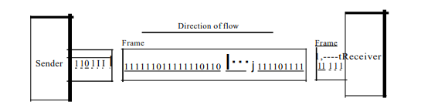
Synchronous Serial Communication
Without gaps and start and stop bits, there is no built-in mechanism to help the receiving device adjust its bit synchronization midstream.
Timing becomes very important, therefore, because the accuracy of the received information is completely dependent on the ability of the receiving device to keep an accurate count of the bits as they come in.

Slide 13
Synchronous Serial Communication
The advantage of synchronous transmission is speed. With no extra bits or gaps to introduce at the sending end and remove at the receiving end, and, by extension, with fewer bits to move across the link, synchronous transmission is faster than asynchronous transmission. For this reason, it is more useful for high-speed applications such as the transmission of data from one computer to another.

Slide 14
Universal asynchronous receiver/transmitter (UART)
A universal asynchronous receiver/transmitter (UART), is a computer hardware device for asynchronous serial communication in which the data format and transmission speeds are configurable.
Essentially, the UART acts as an intermediary between parallel and serial interfaces. On one end of the UART is a bus of eight-or-so data lines (plus some control pins), on the other is the two serial wires - RX and TX.

Slide 15
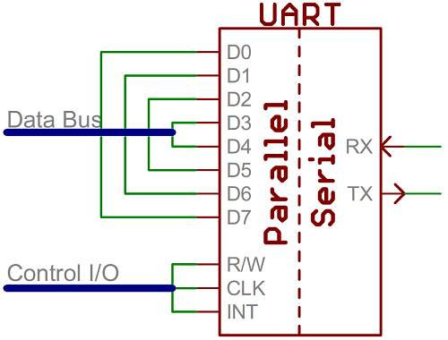
Universal asynchronous receiver/transmitter (UART)

Slide 16
Universal asynchronous receiver/transmitter (UART)
UARTs do exist as stand-alone ICs, but they’re more commonly found inside microcontrollers.
For example, the Arduino Uno - based on the “old faithful” ATmega328 - has just a single UART, while the Arduino Mega - built on an ATmega2560 - has a whopping four UARTs.
UART is becoming less common.
It has been replaced by faster and sophisticated interfaces such as USB, Ethernet, SPI, I2C.
Still used when simple low speed communication is needed.

Slide 17
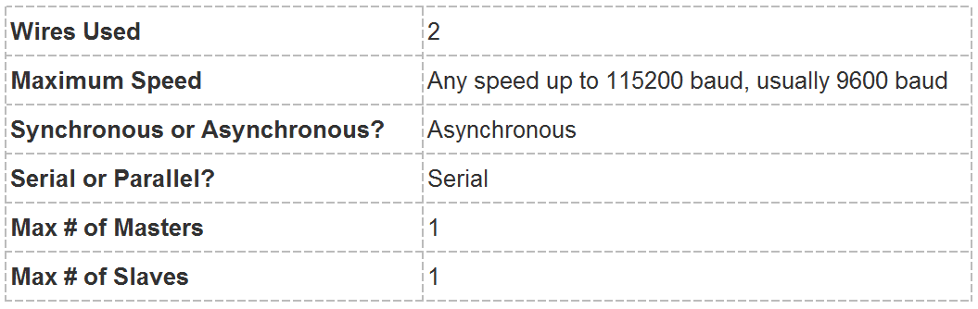
Universal asynchronous receiver/transmitter (UART)

Slide 18
How UART works
In UART communication, two UARTs communicate directly with each other.
The data bus is used to send data to the UART by another device like a CPU, memory, or microcontroller.
Data is transferred from the data bus to the transmitting UART in
parallel form.
After the transmitting UART gets the parallel data from the data bus, it adds a start bit, a parity bit, and a stop bit, creating the data packet.
Next, the data packet is output serially, bit by bit at the Tx pin.

Slide 19
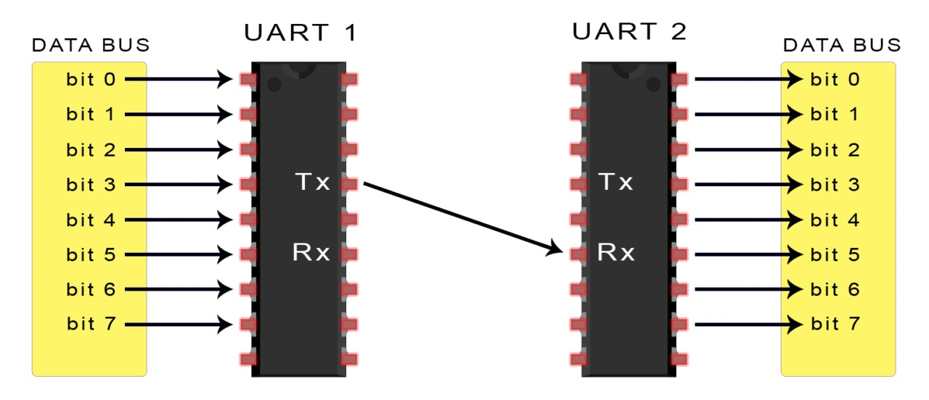
How UART works
The receiving UART reads the data packet bit by bit at its Rx pin.
The receiving UART then converts the data back into parallel form and removes the start bit, parity bit, and stop bits.
Finally, the receiving UART transfers the data packet in parallel to
the data bus on the receiving end.

Slide 20
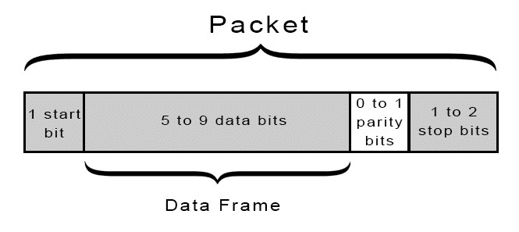
How UART works
UART transmitted data is organized into packets. Each packet contains 1 start bit, 5 to 9 data bits (depending on the UART), an optional parity bit, and 1 or 2 stop bits:

Slide 21
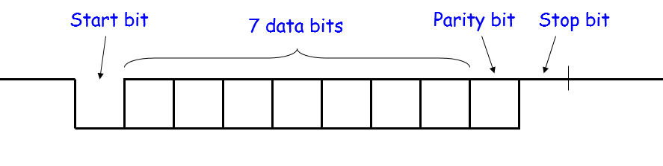
How UART works
In the configuration shown, it takes 10 bits to send 7 bits of data
Transmission efficiency is 7/10, or 70%.

Slide 22
Universal asynchronous receiver/transmitter (UART)
START BIT
The UART data transmission line is normally held at a high voltage level when it’s not transmitting data. To start the transfer of data, the transmitting UART pulls the transmission line from high to low for one clock cycle. When the receiving UART detects the high to low voltage transition, it begins reading the bits in the data frame at the frequency of the baud rate.

Slide 23
Universal asynchronous receiver/transmitter (UART)
DATA FRAME
The data frame contains the actual data being transferred. It can be 5 bits up to 8 bits long if a parity bit is used. If no parity bit is used, the data frame can be 9 bits long. In most cases, the data is sent with the least significant bit first.

Slide 24
Universal asynchronous receiver/transmitter (UART)
PARITY
Parity describes the evenness or oddness of a number. The parity bit is a way for the receiving UART to tell if any data has changed during transmission. Bits can be changed by electromagnetic radiation, mismatched baud rates, or long distance data transfers. After the receiving UART reads the data frame, it counts the number of bits with a value of 1 and checks if the total is an even or odd number. If the parity bit is a 0 (even parity), the 1 bits in the data frame should total to an even number. If the parity bit is a 1 (odd parity), the 1 bits in the data frame should total to an odd number. When the parity bit matches the data, the UART knows that the transmission was free of errors. But if the parity bit is a 0, and the total is odd; or the parity bit is a 1, and the total is even, the UART knows that bits in the data frame have changed.

Slide 25
Universal asynchronous receiver/transmitter (UART)
STOP BITS
To signal the end of the data packet, the sending UART drives the data transmission line from a low voltage to a high voltage for at least two bit durations.

Slide 26
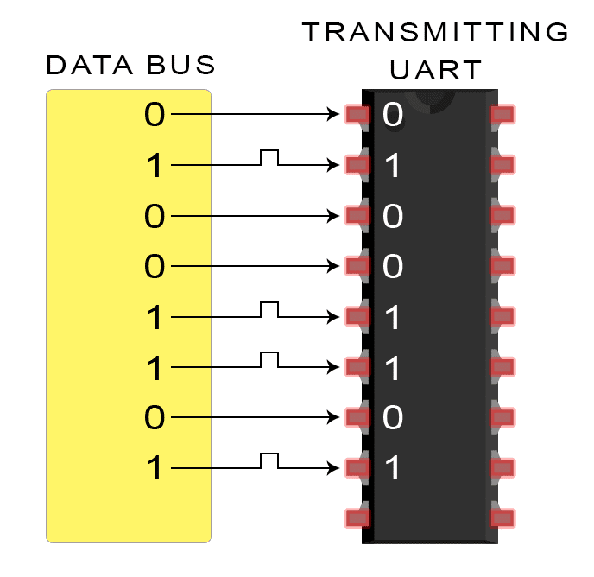
Steps of UART transmission
1. The transmitting UART receives data in parallel from the data bus:

Slide 27
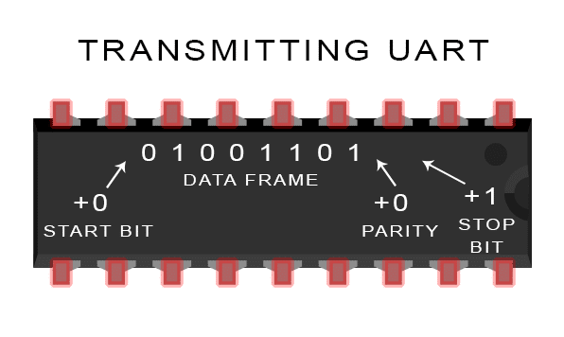
Steps of UART transmission
2. The transmitting UART adds the start bit, parity bit, and the stop bit(s) to the data frame:

Slide 28
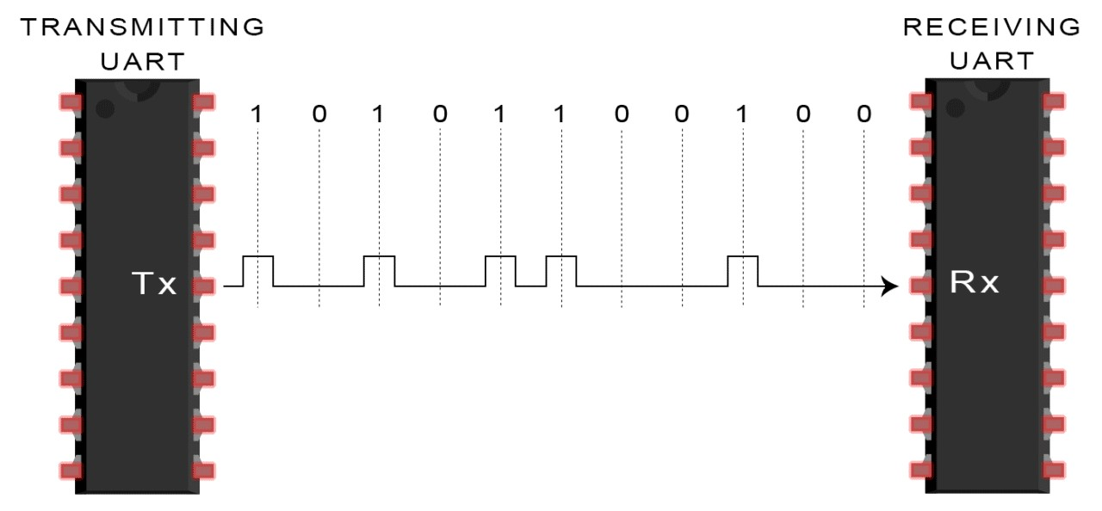
Steps of UART transmission
3. The entire packet is sent serially from the transmitting UART to the receiving UART. The receiving UART samples the data line at the pre- configured baud rate:

Slide 29
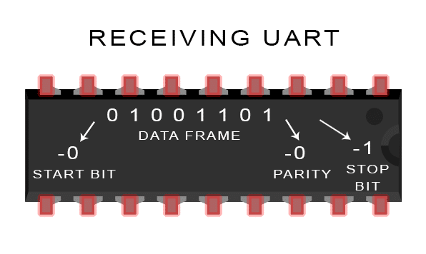
Steps of UART transmission
4. The receiving UART discards the start bit, parity bit, and stop bit from the data frame:

Slide 30
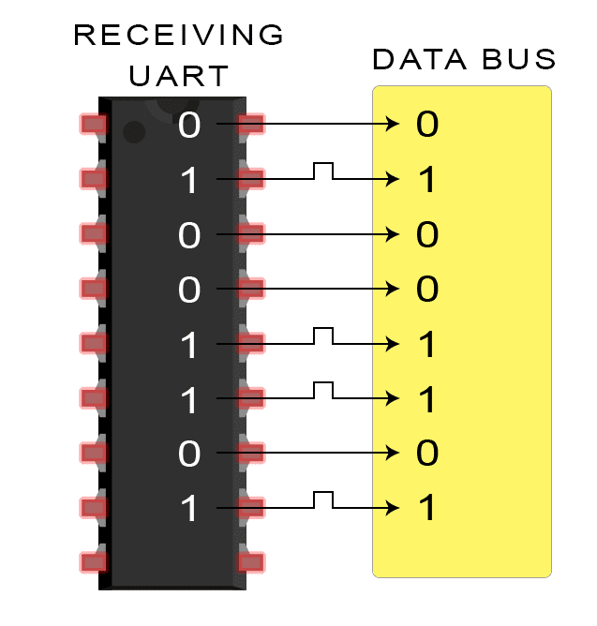
Steps of UART transmission
5. The receiving UART converts the serial data back into parallel and transfers it to the data bus on the receiving end:

Slide 31
Advantages of UART
Only uses two wires
No clock signal is necessary
Has a parity bit to allow for error checking
The structure of the data packet can be changed as long as both sides are set up for it
Well documented and widely used method

Slide 32
Disadvantages of UART
The size of the data frame is limited to a maximum of 9 bits
Doesn’t support multiple slave or multiple master systems

Slide 33
UART communication in Arduino
int ledPin = 13; char state = 0; void setup() {
pinMode(ledPin, OUTPUT); Serial.begin(9600);
}
void loop() { if(Serial.available() > 0){ state = Serial.read();
}
if (state == '0') digitalWrite(ledPin, LOW);
if (state == '1') digitalWrite(ledPin, HIGH);
}

Slide 34
UART communication in Arduino
Serial.begin()
Sets the data rate in bits per second (baud) for serial data transmission. For communicating with the computer, use one of these rates: 300, 600, 1200, 2400, 4800, 9600, 14400, 19200, 28800, 38400, 57600, or 115200.
Syntax:
Serial.begin(speed)
Arduino Mega only:
Serial1.begin(speed) Serial2.begin(speed) Serial3.begin(speed)

Slide 35
UART communication in Arduino
Serial.available()
Get the number of bytes (characters) available for reading from the serial port.
Syntax:
Serial.available( )
Arduino Mega only:
Serial1.available( )
Serial2.available( ) Serial3.available( )

Slide 36
Serial Peripheral Interface (SPI)
Serial Peripheral Interface (SPI) is an interface bus or communication
protocol commonly used to send data between microcontrollers and
small peripherals such as shift registers, sensors, and SD cards.
Peripherals
LCDs
Sensors
Lots of other chips
Microcontrollers
Almost all MCUs have SPI masters
Some have SPI slaves

Slide 37
Serial Peripheral Interface (SPI)
One unique benefit of SPI is the fact that data can be transferred without interruption. Any number of bits can be sent or received in a continuous stream.
Devices communicating via SPI are in a master-slave relationship.
The master is the controlling device (usually a microcontroller), while the slave (usually a sensor, display, or memory chip) takes instruction from the master.
The simplest configuration of SPI is a single master, single slave system,
but one master can control more than one slave.

Slide 38
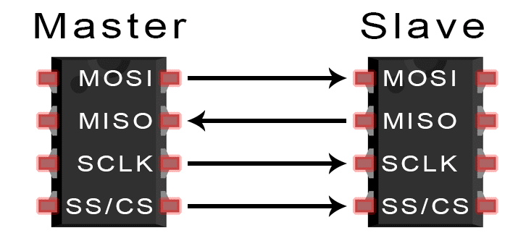
Serial Peripheral Interface (SPI)

Slide 39
Serial Peripheral Interface (SPI)
MOSI (Master Output/Slave Input) – Line for the master to send data to the slave.
MISO (Master Input/Slave Output) – Line for the slave to send data to the master.
SCLK (Clock) – Line for the clock signal.
SS/CS (Slave Select/Chip Select) – Line for the master to select which slave to send data to.

Slide 40
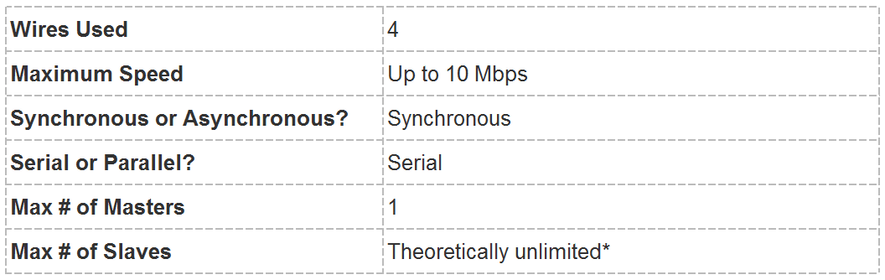
Serial Peripheral Interface (SPI)

Slide 41
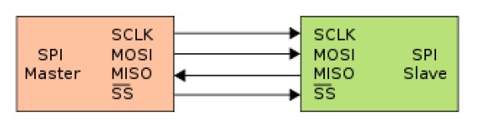
HOW SPI WORKS
In SPI, only one side generates the clock signal.
The side that generates the clock is called the “master”, and the other side is called the “slave”.
There is always only one master (almost always the microcontroller),
but there can be multiple slaves.

Slide 42
HOW SPI WORKS
When data is sent from the master to a slave, it’s sent on a data line called MOSI, for “Master Output / Slave Input”.
If the slave needs to send a response back to the master, the master will continue to generate a prearranged number of clock cycles.
The slave will put the data onto a third data line called MISO, for “Master
Input / Slave Output”.
Because the master always generates the clock signal, it must know in advance when a slave needs to return data and how much data will be returned.

Slide 43
HOW SPI WORKS
There’s one last line, called SS for Slave Select.
It tells the slave that it should wake up and receive/send data.
Also used when multiple slaves are present to select the one to talk to.
The SS line is normally held high, which disconnects the slave from the SPI bus. Just before data is sent to the slave, the line is brought low, which activates the slave. When you’re done using the slave, the line is made high again.

Slide 44
MULTIPLE SLAVES
SPI can be set up to operate with a single master and a single slave, and it can be set up with multiple slaves controlled by a single master. There are two ways to connect multiple slaves to the master.
1. Separate SS line
In general, each slave will need a separate SS line. To talk to a particular slave, it is necessary to make that slave’s SS line low and keep the rest of them high (don’t want two slaves activated at the same time, or they may both try to talk on the same MISO line resulting in garbled data). Lots of slave will require lots of SS line.

Slide 45
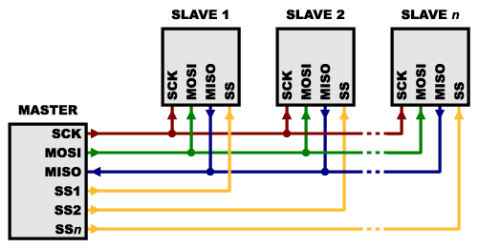
MULTIPLE SLAVES

Slide 46
MULTIPLE SLAVES
2. Single SS line
Some parts prefer to be daisy-chained together, with the MISO (output) of one going to the MOSI (input) of the next. In this case, a single SS line goes to all the slaves. Once all the data is sent, the SS line is raised, which causes all the chips to be activated simultaneously. This is often used for daisy-chained shift registers and addressable LED drivers.

Slide 47
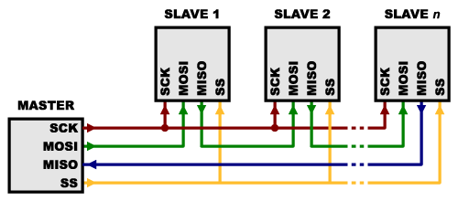
MULTIPLE SLAVES

Slide 48
MULTIPLE SLAVES
Note that, for this layout, data overflows from one slave to the next, so to send data to any one slave, you’ll need to transmit enough data to reach all of them. Also, keep in mind that the first piece of data you transmit will end up in the last slave.
This type of layout is typically used in output-only situations, such as driving LEDs where you don’t need to receive any data back. In these cases you can leave the master’s MISO line disconnected.
However, if data does need to be returned to the master, you can do this by closing the daisy-chain loop (blue wire in the above diagram).

Slide 49
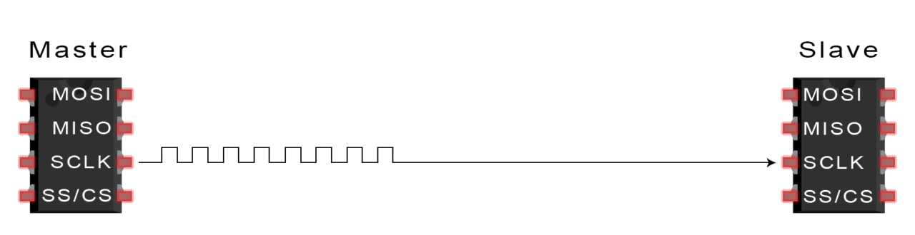
STEPS OF SPI DATA TRANSMISSION
1. The master outputs the clock signal:

Slide 50
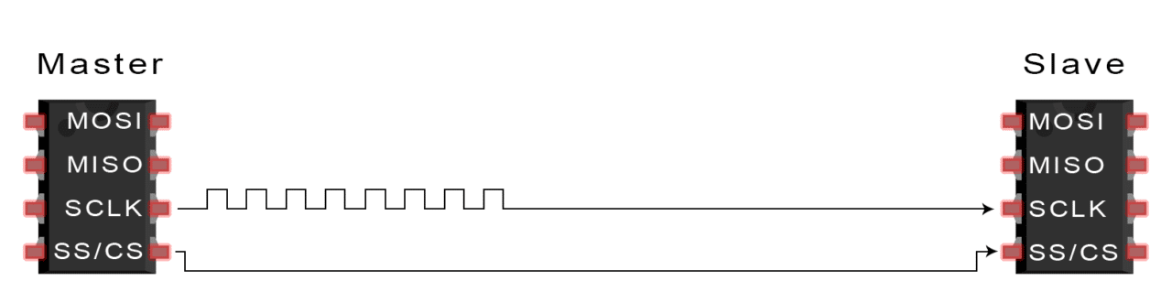
STEPS OF SPI DATA TRANSMISSION
2. The master switches the SS/CS pin to a low voltage state, which activates the slave:

Slide 51
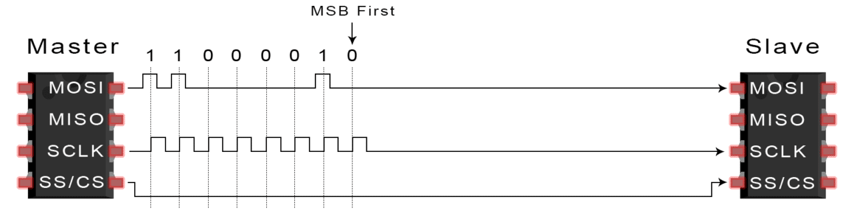
STEPS OF SPI DATA TRANSMISSION
3. The master sends the data one bit at a time to the slave along the MOSI line. The slave reads the bits as they are received:

Slide 52
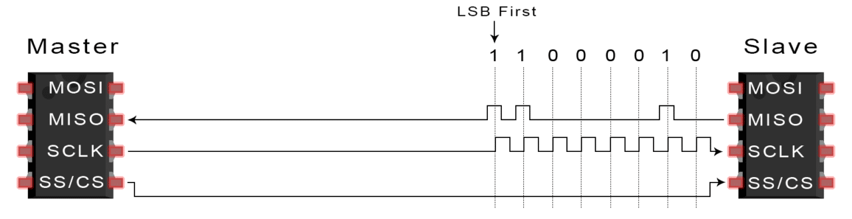
STEPS OF SPI DATA TRANSMISSION
4. If a response is needed, the slave returns data one bit at a time to the master along the MISO line. The master reads the bits as they are received:

Slide 53
ADVANTAGES OF SPI
No start and stop bits, so the data can be streamed continuously without interruption
No complicated slave addressing system like I2C
Higher data transfer rate than I2C (almost twice as fast)
Separate MISO and MOSI lines, so data can be sent and received at the same time

Slide 54
DISADVANTAGES OF SPI
Uses four wires (I2C and UARTs use two)
No acknowledgement that the data has been successfully received
(I2C has this)
No form of error checking like the parity bit in UART
Only allows for a single master

Slide 55
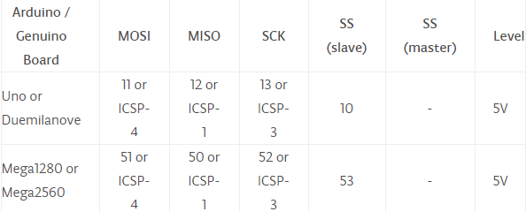
Arduino SPI library
Connections

Slide 56
THANK YOU

